Slide 1
Development of different paradigms

Slide 2
Limitations of the imperative paradigm
difficulty with solving certain types of problems
the need to specify code for every individual process
difficulty of coding for variability

Slide 3
Difficulty with solving certain types of problems
The imperative paradigm was intended to solve mathematical and arithmetical problems
Many problems do not have real answers or have a variety of different answers
Many problems require solutions that are not feasible to develop in strict mathematical or arithmetical terms

Slide 4
The need to specify code for every individual process
Requires the developer to understand all details of the problem and be able to solve the problem completely
Sometimes the entire problem cannot be easily understood
The entire solution needs to be developed before it can operate
Testing is extremely difficult or not possible until all aspects of the solution are completed down to the lowest level

Slide 5
Difficulty of coding for variability
Many parts of code are repeatedly re-used for different parts of the solution
Imperative programs do not completely support re-usable code
Subprograms and copying/pasting code offers limited reusability and will often require more work to make the code function properly

Slide 6
Emerging technologies
Machine languages (E.g. Assembler) were specific to different types of machines
Code cannot be used on different machines when using machine specific languages
Humans were required to think in machine language (binary digits) to work with them
At the time, this was considered a breakthrough and separated the human from the computer (which does all the hard work), however now it seen as extremely primitive
The exponential increase in the speed of technological advancement has allowed the programmer to be free of knowledge of machine code
The final solution is not as efficient as a machine code product, however the development is significantly easier and faster
Programs are now able to be written in languages that
Are human readable (to a certain extent)
Are able to be used on multiple types of machines

Slide 7
Simplifying the development and testing of some larger software projects
Speed of code generation
Programming languages that increase the speed of code generation increase productivity, as programmers can write more effective code in less time by choosing the most appropriate paradigm
Approach to testing
Programming languages that reduce the time or effort required for testing are desirable to hasten development

Slide 8
Simplifying the development and testing of some larger software projects
Effect on maintenance
Modular programming reduces maintenance time as errors are easier to locate and correct in smaller modules
Efficiency of solution once coded
Programming languages vary in their level of efficiency depending on the computer processor and the level of modularity in the code

Slide 9
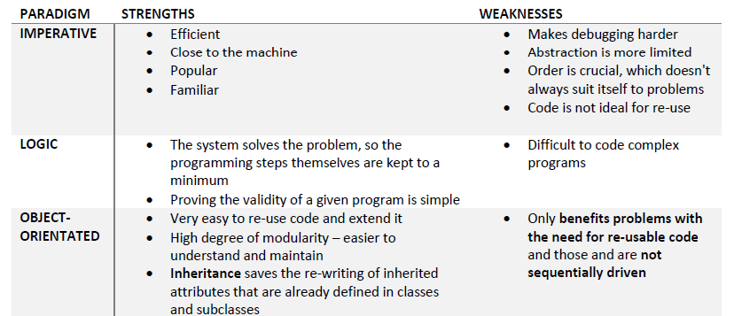
Strengths and Weakness

Slide 10
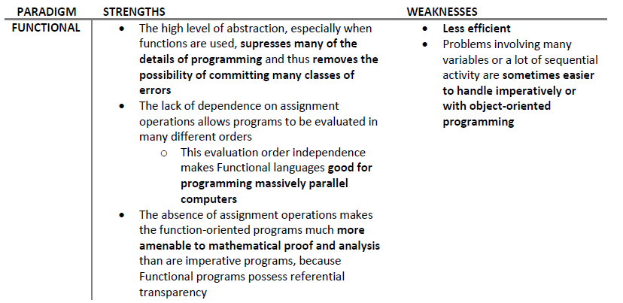
Strengths and Weakness

Slide 11
An acronym to help you remember the syllabus dot points for the reasons for the development of the different paradigms is LESS.
Limitations of the Imperative Paradigm
Emerging Technologies
Simplifying the development and testing of some larger software projects
Strengths of different paradigms

